Slide 1
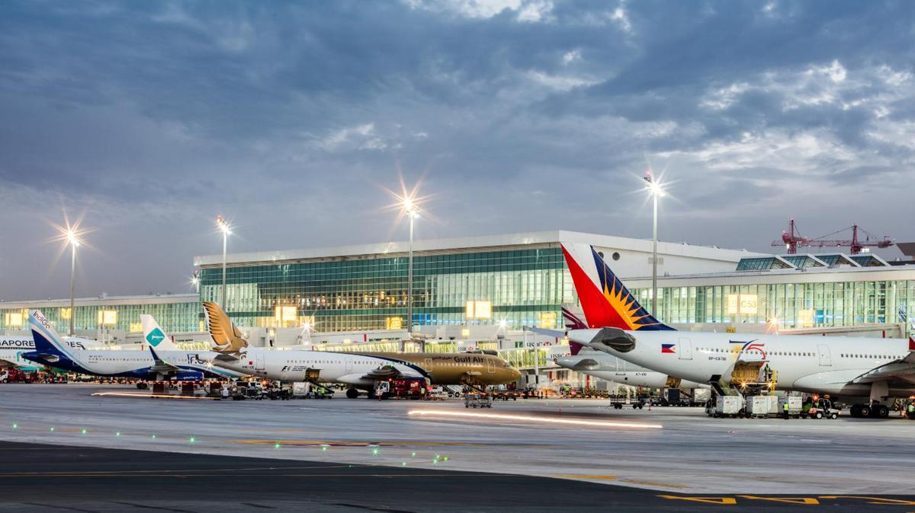

Predicting Upcoming Flight Delays
Shalini Jain
DATA 606 - Delivery 3
Notes:
Hey guys i’m Shalini, this is my DATA 606 delivery 2 presentation. Just as a reminder, I am working on predicting upcoming flight delays.

Slide 2
Project Recap
● To predict upcoming flight delays based on previous delays
● Help to prevent future delays
● Help consumers know which airlines/airports to use and/or avoid

Slide 3

Delivery 3 Topics
Project updates
Data Cleansing
Exploratory Data Analysis
Model Construction
Next Steps

Slide 4

Project Updates
Changed historical weather API
World Weather Online
Focussed on Historical Weather (EDA)?

Slide 5
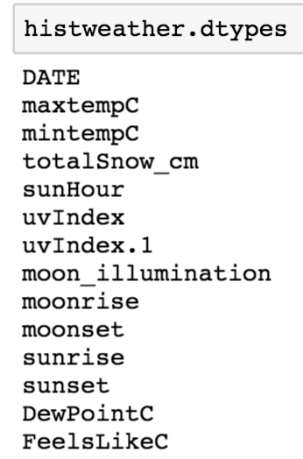
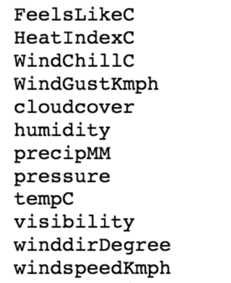
World Weather Online API
Notes:
total snow, windgust, cloudgover, windspeed

Slide 6
Exploratory Data Analysis
Notes:
Dropped Columns

Slide 7
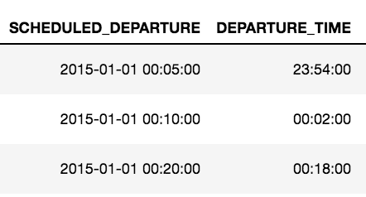
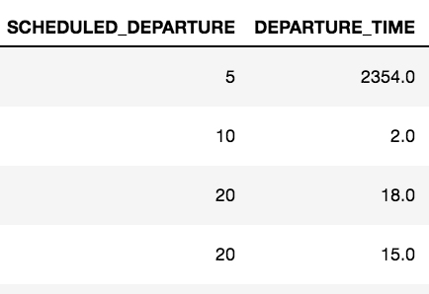
Exploratory Data Analysis
Notes:
Airlines:
EV - Atlantic Southeast Airlines
WN - SouthWest
DL - Delta Airlines
OO - Skywest
B6 - Jetblue
Nk - Spirit
#average arrival_delays by airline

Slide 8
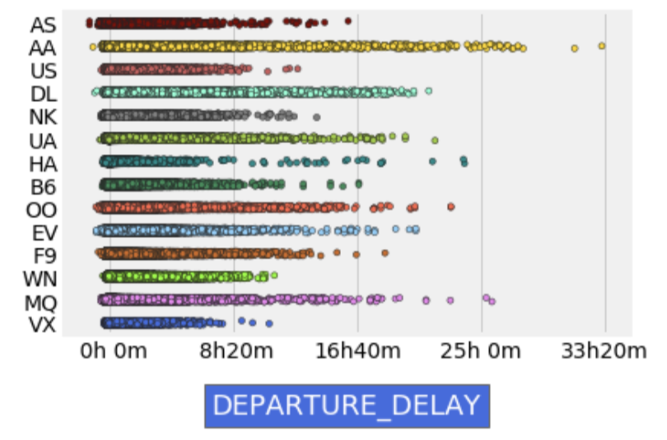
Exploratory Data Analysis
Notes:
Departure delays based on airlines.
AA has a lot of delays. VX doesnt….

Slide 9
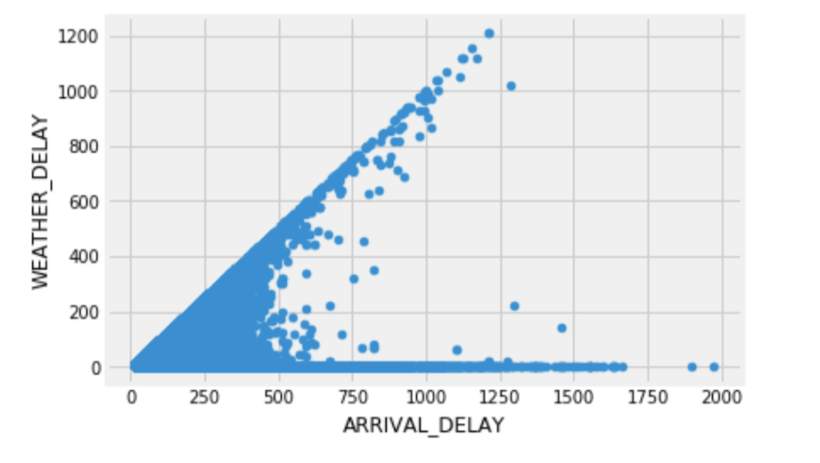
Exploratory Data Analysis
Notes:
Looking at correlation between arrival delay and weather delay

Slide 10
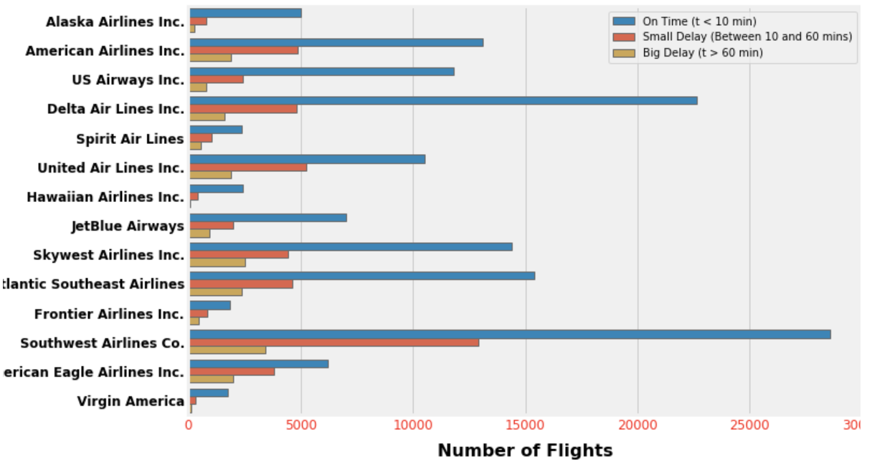
Exploratory Data Analysis
Notes:
Number of flights to get a better idea of each airline and the number of flights that have been delayed.
South West (NW)

Slide 11
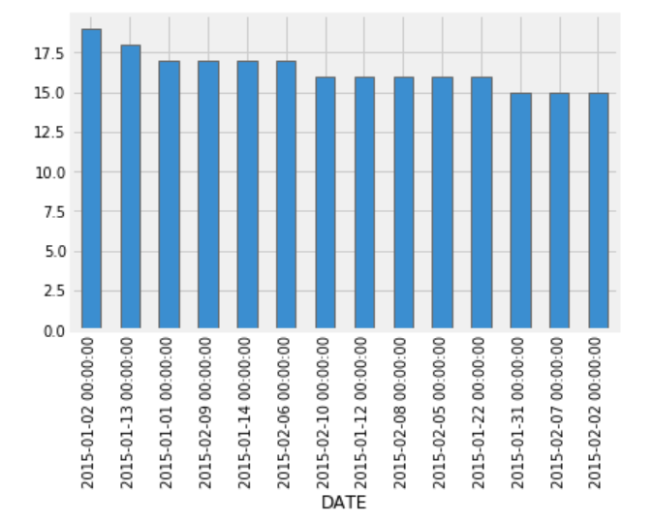
Exploratory Data Analysis
Notes:
Just wanted to show average wind-speed based on the dates.

Slide 12
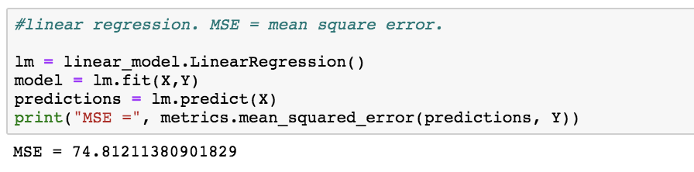
Model Construction
Notes:
-Working on Linear and Polynomial Regression
-departure minutes
-Will be using other ML algorithms on my data as well
-Want to compare the accuracy of the models

Slide 13

Next Steps
Confirming which algorithms I will use
Implementing the algorithms
Improving current model
Work on more visualizations
Delivery 4:
concrete outcomes
Evaluate performance of models

Slide 14

Questions?
Please contact me via email: sjain3@umbc.edu

Slide 15
Resources
https://www.kaggle.com/usdot/flight-delays#airlines.csv
https://arxiv.org/pdf/1903.06740.pdf
https://engineering.upside.com/applying-predictive-analytics-to-flight-delays-85413ca4939f

